Slide 1
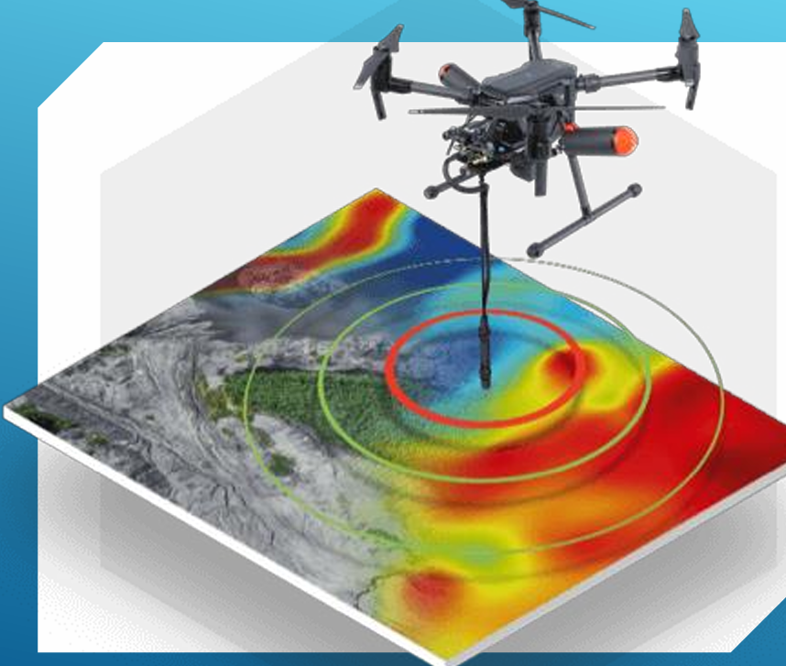
SMART FARMING APPLICATIONS WITH IMAGE PROCESSING TECHNOLOGIES FOR DEVELOPING STEM SKILLS IN VOCATIONAL EDUCATION
KA 220 VET 250.000 EURO

Slide 2
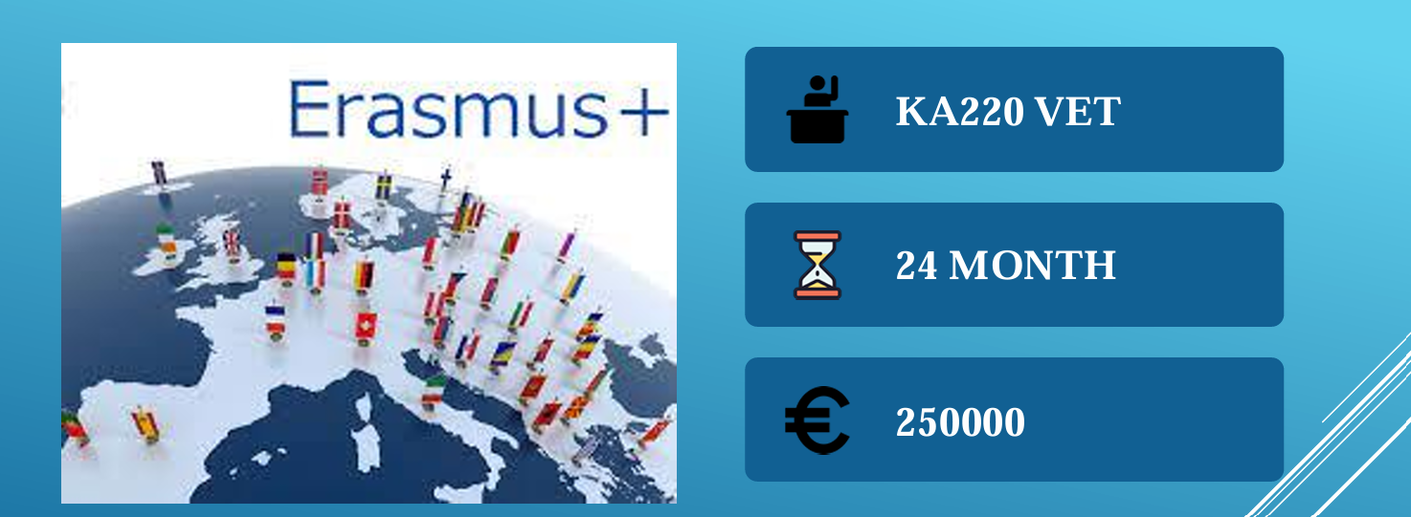

THER-MA SAT FARMING

Slide 3
PROJECT PARTNERS
1- Zespół Szkół Centrum Kształcenia Rolniczego im. Stanisława Staszica w Swarożynie (Coordinator ) (Agricultural VET School) Swarozyn, Poland
2-ISTITUTO TECNICO COMMERCIALE «G.P. CHIRONI» (Aviation VET School ) Sardinia-Nuoro, Italy (High level Drone expertise)
3-Muratpaşa Mesleki ve Teknik Anadolu Lisesi (Technical VET SCHOOL ) Antalya, Türkiye (IT Expertise-Medium level drone expertise)
4-Agronomska skola Zagreb (Agricultural VET School) Zagreb,Croatia (Agricultural VET School)
5- AIR3DMAP LIMITED COMPANY (Remote Sensing Expertise) Antalya, Türkiye
6- Liceul Tehnologic «Bratianu» Dragaşani, Romania (Drone Expertise and Agriculture Department)

Slide 4
PR 1: Basic UAV Training and Drone Kit Design PR 2: Remote Sensing and Image Processing Kit and Training Modules PR 3: Dissemination, Creation of e-book and Virtual Museum
PROJECT RESULTS

Slide 5
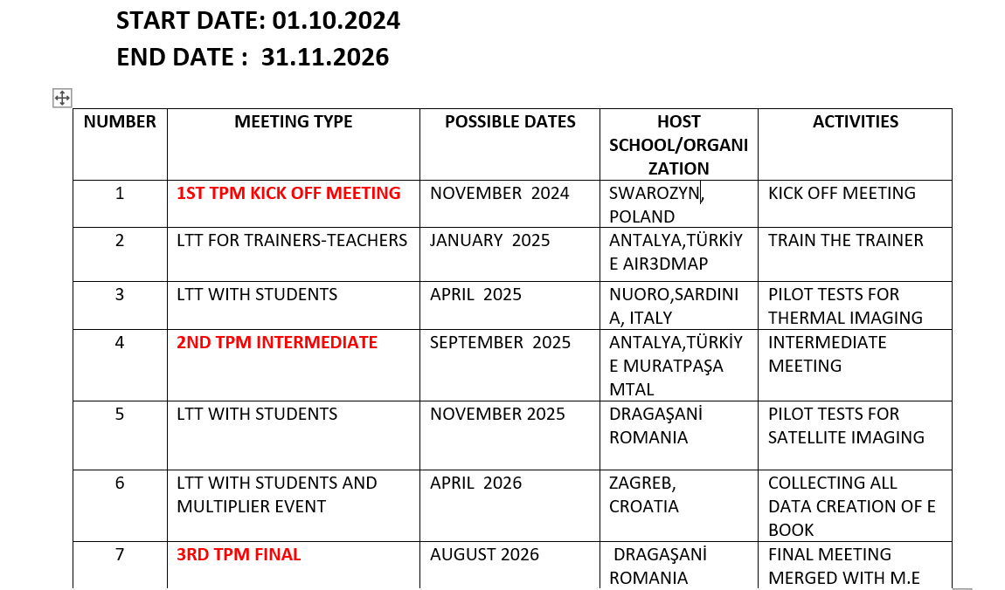
MOBILITIES

Slide 6
WORK PACKAGE 1 Project Management
WP LEADER Coordinator-Zespół Szkół
Zespół Szkół
coordinate, provide effective communication among all partners, supervise planning,
Budget control, time sheets preparement and task allocation.
implementation, evaluation, dissemination of all the project activities and products, compose the final report, disseminate all main project's outcomes on the EU Dissemination Platform
All partners will be responsible for:
local, regional and national cooperation with own stakeholders and educational institutions;
dissemination, communication;
publications, participating to the study material and manuals composing;
implementing the project activities, participating the transnational project meetings, preliminary tasks to ensure successful meetings;
ensuring academic level of activities.

Slide 7
WORK PACKAGE 2 Basic UAV Training and Drone Kit Design WP LEADER G.P CHRONI (TR) CO LEADER Liceul Tehnologic (RO)
2 main results will be produced and integrated to MOOC platform as a results of this work package;
1-Basic unmanned aerial vehicle training consisting of 10 modules.
2-Basic level drone design-manufacturing guide, consisting of 10 Modules.

Slide 8
WORK PACKAGE 2 Basic UAV Training and Drone Kit Design
1-UNMANNED AIRCRAFT TRAINING
M1: Technologies, Aerodynamics and Performance. (ISTITUTO TECNICO COMMERCIALE "1-2 G.P. CHIRONI-S. SATTA)
M2: Propulsion Systems. (ISTITUTO TECNICO COMMERCIALE "1-2 G.P. CHIRONI-S. SATTA)
M3: RC, Avionics and Display Systems. (ISTITUTO TECNICO COMMERCIALE "1-2 G.P. CHIRONI-S. SATTA)
M4: Autonomous Flight and Ground Station Systems. (ISTITUTO TECNICO COMMERCIALE "1-2 G.P. CHIRONI-S. SATTA)
M5: Civil Aviation rules. (ZESPOL SZKOL CENTRUM)
M6: Meteorology and Flight Safety. (ZESPOL SZKOL CENTRUM)
M7: Basic Level Design. (LICEUL TEHNOLOGIC BRATIANU)
M8: Maintenance and Repair. (LICEUL TEHNOLOGIC BRATIANU)
M9: Using a Drone with special equipment (thermal and multispectral camera) (AIR3DMAP COMPANY)
M10: Softwares and applications to analyze images gathered by drone (analysis of thermal images for agricultural purposes) (AIR3DMAP COMPANY)

Slide 9
WORK PACKAGE 2 Basic UAV Training and Drone Kit Design
2-DRONE DESIGN-PRODUCTION GUIDE
M1-Different types of multi-rotor UAVs (AIR3DMAP COMPANY)
M2-Flight terminology Roles of ESC (AIR3DMAP COMPANY)
M3-Drone flight (AIR3DMAP COMPANY)
M4-LiPo batteries (AIR3DMAP COMPANY)
M5- GPS in flight (ZESPOL SZKOL CENTRUM)
M6-Radio receiver and transmitter systems (ZESPOL SZKOL CENTRUM)
M7-Pre-flight checks (LICEUL TEHNOLOGIC BRATIANU)
M8-Assembling a quadcopter from commercially available parts (LICEUL TEHNOLOGIC BRATIANU)
M9-Required Software and controller (ISTITUTO TECNICO COMMERCIALE "1-2 G.P. CHIRONI-S. SATTA)
M10-Basic safety and legal requirements (ISTITUTO TECNICO COMMERCIALE "1-2 G.P. CHIRONI-S. SATTA)

Slide 10
WORK PACKAGE 2 Basic UAV Training and Drone Kit Design
TASK DISTRIBUTION:
Creating the content of the Learning Modules (IT, RO)
Testing and evaluation of the learning modules on learners/students (all)
Reporting progress to the work package leader (all)
Providing feedback and suggestions on the development of the learning modules (all)
Evaluation Grid for the content of modules (HR, RO, TR Muratpaşa)
LTT for trainers (TR AIR3DMAP)
Thermal Drone Kit purchase (IT and TR will guide partners)

Slide 11
WORK PACKAGE 2 Basic UAV Training and Drone Kit Design
The partners will also provide two week practical training for "UAV 1 piloting" for their students after they complete the theoretical training. Partners agreed upon to provide the training to receive the drone piloting certificates, experienced partners, AIR3DMAP and G.P Chroni will provide guidance for the training.
20 persons per partner, in total 100 persons will get drone licence.This training should be provided to 20 students from each partner school.Partners will organize the training locally.
SUGGESTION:
AIR3DMAP and Muratpaşa can organize training as summer school in accordance with Akdeniz University Aviation Department. Students with their teachers can join the training in Antalya in July 2025. The department has authorised personnel and accreditation to give the training.
The Project management budget can be used for travelling expenses or volunteeer students can pay for the training.

Slide 12
WORK PACKAGE 3: Remote Sensing and Image Processing Kit and Training Modules WP LEADER AIR3DMAP COMPANY (TR) CO LEADER AGRONOMSKA SKOLA (HR)
A Training Kit for trainers/teachers for the application of remote sensing and image processing technology to be used in smart farming in the development of STEM applications in vocational education. The topics and application areas in the
authoring toolkit will be developed according to the Digital Competences Framework, which provides a reference for 4.0 competences required and applied in the Information and Communication Technology (ICT) workplace, using a common language for competences, skills and qualification levels that can be
understood across Europe.

Slide 13
WORK PACKAGE 3: Remote Sensing and Image Processing Kit and Training Modules WP LEADER AIR3DMAP COMPANY (TR) CO LEADER AGRONOMSKA SKOLA (HR)
The Modules related to "Remote Sensing and Image Processing" will include:
1.Image Processing Techniques, data mining and machine learning. (LICEUL TEHNOLOGIC BRATIANU)
2. Fundamentals of Remote Sensing (ISTITUTO TECNICO COMMERCIALE "1-2 G.P. CHIRONI-S. SATTA)
3. Electromagnetic Spectrum (ISTITUTO TECNICO COMMERCIALE "1-2 G.P. CHIRONI-S. SATTA)
4. UAV and UAV Imaging Technologies (LICEUL TEHNOLOGIC BRATIANU)
5. Satellite and Satellite Imaging Technology (AIR3DMAP COMPANY)
6. Data Sources (ESA, GEE, NASA, OSM) (AIR3DMAP COMPANY)
7.Downloading / Obtaining Image Data (AIR3DMAP COMPANY)

Slide 14
WORK PACKAGE 3: Remote Sensing and Image Processing Kit and Training Modules WP LEADER AIR3DMAP COMPANY (TR) CO LEADER AGRONOMSKA SKOLA (HR)
Learning Modules related to Smart farming via Image Processing will include;
1.Using thermal imaging technology in agricultural applications. (ISTITUTO TECNICO COMMERCIALE "1-2 G.P. CHIRONI-S. SATTA)
2.Obtaining land use types of agricultural fields by applying image processing to satellite images. (ZESPOL SZKOL CENTRUM)
3.Soil Properties via thermal and satellite imaging (AIR3DMAP COMPANY)
4.Drone Image Analysis for Crop Damage Assessment (LICEUL TEHNOLOGIC BRATIANU)
5.Heat maps of fields obtained by thermal-infrared image processing. (AIR3DMAP COMPANY)

Slide 15
WORK PACKAGE 3: Remote Sensing and Image Processing Kit and Training Modules WP LEADER AIR3DMAP COMPANY (TR) CO LEADER AGRONOMSKA SKOLA (HR)
Aviation school/organization partners will contribute to the development of the Remote Sensing and Image Processing Learning modules according to their area of expertise
Agricultural school partners will contribute the development of smart farming learning modules content
All partners will participate in meetings and communication with the work package leader and other partners involved in the work package.
All partners will provide feedback and suggestions on the development of the learning modules.
All partners will contribute to the testing and evaluation of the learning modules on learners/students
All partners will ensure that deliverables are completed on time and to the required quality standards.
All partners will report progress to the work package leader

Slide 16
WORK PACKAGE 3: Remote Sensing and Image Processing Kit and Training Modules WP LEADER AIR3DMAP COMPANY (TR) CO LEADER AGRONOMSKA SKOLA (HR)
TASK DISTRIBUTION:
User manuel (AIR3DMAP)
2 Learning Teaching Training meeting organized for students (pilot tests in IT, RO) (preparation HR, RO, TR-Muratpaşa )
Revisions and feedback from participants (questionairres after each LTT)
Virtual meetings
Evaluation reports (all partners) preparation of template PL and IT
Surveys and interviews (preparation HR, RO, TR-Muratpaşa )
Achievements Certificates after trainings (TR-IT)

Slide 17
WORK PACKAGE 4 Dissemination, Creation of e-book and Virtual Museum WP LEADER Coordınator-Zespół Szkół CO LEADER MURATPAŞA MTAL
These dissemination activities will serve the purpose of initiating the project results and presenting the 2 training kits, OERs, the MOOC platform and the e book in order to reach wider and more interested groups in the future post-project.
setting the timetable of the conference-seminar-workshop and sharing the tasks among the partners.
development of the Inclusion strategy of the dissemination plan.
preparing the agenda of the conference-seminar-workshop and determining who will be a participant.
public relations activities
realization of dissemination activities
collection of all the data
creation of e book
creation of the Project Virtual Museum
"National level stakeholder seminars" in each country and "International level stakeholder seminar" as a Multiplier Event in HR

Slide 18
WORK PACKAGE 4 Dissemination, Creation of e-book and Virtual Museum WP LEADER Coordınator-Zespół Szkół CO LEADER MURATPAŞA MTAL
TASK DISTRIBUTION:
*For branding and professional visibility, "Muratpaşa MTAL" will be responsible for a brand guide project (All partners) to create a visual identity and important messages (creation of professional design materials such as official brochure, pop-up stand,)
*THERMA-SAT FARMING will acquire the domain name and coordinator will do the website development. It will work in coordination with "Muratpaşa MTAL".
*E book will be created under the guidance of coordinator and Muratpaşa all partners will contribute by sending materials.
*Virtual museum will be created under the guidance of G.P Chorini all partners will contribute
*LTT with students in Croatia will be organized.
* TPM merged with M.E will be organized under the coordination of RO

Slide 19
WORK PACKAGE 4 Dissemination, Creation of e-book and Virtual Museum WP LEADER Coordınator-Zespół Szkół CO LEADER MURATPAŞA MTAL
TASK DISTRIBUTION:
* SOCIAL MEDIA NETWORKS PL (already in use)
*NEWSLETTERS EVERY 6 MONTHS HR, RO, IT, PL, TR
*MODULE EVALUATION GRIDS ON USERS HR AND RO
*EVALUATION SURVEYS AFTER EACH LTT (HOST PARTNER)
*REPORTS ON EVALUATION GRIDS APPLIED ON USERS ( SCHOOLS )
*PREPARING MEETING AGENDA AND INFOPACK FOR GUEST PARTNERS AT LEAST 1 MONTH BEFORE EACH MOBILITY (ALL PARTNERS)

Slide 20
PROJECT MEETINGS 1- KIck Off IN Poland ın NOVEMBER 2024 2- ıNtermedıate meetıng ın türkiye ın september 2025 3- Closure ın ROMANIA SEPTEMBER 2026 MERGED WITH MULTIPLIER EVENT LEARNING TEACHING TRAINING ACTIVITIES 1- LTT IN TURKIYE; TRAIN THE TRaINER (3 TEACHERS AND EDUCATORS) JANUARY 2025? 2-LTT IN SARDINIA –ITALY ; PILOT TESTS FOR THERMAL IMAGING (5 STUDENTS AND 2 TEACHERS) APRIL 2025 ? 3- LTT IN ROMANIA; PILOT TESTS FOR SATELLITE IMAGING (5 STUDENTS AND 2 TEACHERS) NOVEMBER 2025 4- LTT IN CROATIA ; COLLECTING ALL DATA AND CREATION OF E BOOK (5 STUDENTS AND 2 TEACHERS) aprıl 2026 Multiplier Events: Promotion of the project results and implementation studies for educators working in vocational education in 4 partner countries
PROJECT IMPLEMENTATION

Slide 21
Tıme lıne of the WORK PACKAGES
WORK PACKAGE 1- BASIC UAV TRAINING AND DRONE KIT
START DATE : 01/01/2025
END DATE : 30/06/2025
WORK PACKAGE 2 - REMOTE SENSING AND IMAGE PROCESSING KIT AND TRAINING MODULES
START DATE: 01/12/2024
END DATE: 31/12/2025
WORK PACKAGE 3- E BOOK AND VIRTUAL MUSEUM
START DATE: 01/01/2026
END DATE :01/06/2026

Slide 22
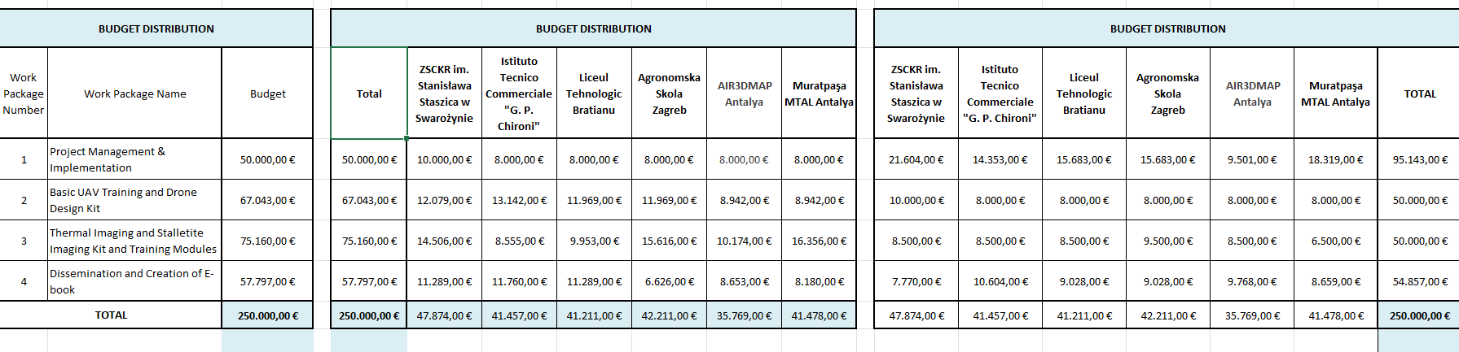
BUDGET DISTRIBUTION

Slide 23
TPM1 BUDGET
MURATPAŞA MTAL : 395 x 2 : 790 EURO FOR TRAVEL
100 X 5 X 2 : 1.000 Euro for Individual Support
Total: 1.790
AIR3DMAP COMPANY:395 x 2 : 790 EURO FOR TRAVEL
100 X 5 X 2 : 1.000 Euro for Individual Support
Total: 1.790
Istituto Tecnico Commerciale: 309 x 2 : 618 EURO FOR TRAVEL
100 X 5 X 2 : 1.000 Euro for Individual Support
Total: 1.618
Agronomska Skola :309 x 2 : 618 EURO FOR TRAVEL
100 X 5 X 2 : 1.000 Euro for Individual Support
Total: 1.618
Liceul Tehnologic: 618 EURO FOR TRAVEL
100 X 5 X 2 : 1.000 Euro for Individual Support
Total: 1.618

Slide 24
ZSCKR im.Stanisława Staszica: 395 x 3 : 1.185 EURO FOR TRAVEL 100 X 7 X 3 : 2.100 Euro for Individual Support Total: 3.265 Istituto Tecnico Commerciale: 309 x 3 : 927 EURO FOR TRAVEL 100 X 7 X 3 : 2.100 Euro for Individual Support Total: 3027 Agronomska Skola :309 x 3 : 927 EURO FOR TRAVEL 100 X 7 X 3 : 2.100 Euro for Individual Support Total: 3027 Liceul Tehnologic: 309 x 3 : 927 EURO FOR TRAVEL 100 X 7 X 3 : 2.100 Euro for Individual Support Total: 3027
LTT 1 BUDGET /ANTALYA 7 DAYS

Slide 25
ZSCKR im.Stanisława Staszica: 309 x 7 : 2.163 EURO FOR TRAVEL 100 X 7 X 2 : 1.400 Euro for STAFF 60 X 7X 5: 2.100 Euro for Students Total: 5.663 Euros MURATPAŞA MTAL: 309 x 7 : 2.163 EURO FOR TRAVEL 100 X 7 X 2 : 1.400 Euro for STAFF 60 X 7X 5: 2.100 Euro for Students Total: 5.663 Euros AIR3DMAP COMPANY: 309 X 3 : 927 EURO FOR TRAVEL : 100 X 7 X 3 : 2.100 Euro for STAFF Total: 3.027 Euros
LTT 2 BUDGET /NUORO 7 DAYS

Slide 26
Agronomska Skola: 309 x 7 : 2.163 EURO FOR TRAVEL 100 X 7 X 2 : 1.400 Euro for STAFF 60 X 7X 5: 2.100 Euro for Students Total: 5.663 Euros Liceul Tehnologic: 309 x 7 : 2.163 EURO FOR TRAVEL 100 X 7 X 2 : 1.400 Euro for STAFF 60 X 7X 5: 2.100 Euro for Students Total: 5.663 Euros
LTT 2 BUDGET /NUORO 7 DAYS

Slide 27
ALL PARTNERS 6.500 EUROS FOR DRONE AS EXCEPTIONAL COST COST FOR FIRST YEAR 1-ZSCKR im.Stanisława Staszica: 3.265 + 5.663 Euros + 6.500 = 15.428 (19.138) 3.710 can be used for Organisational Support 2-MURATPAŞA MTAL: 1.790 + 5.663 Euros + 6.500 = 13.953 (16.591) 2.638 OS 3-AIR3DMAP COMPANY: 1.790 + 3.027 Euros + 6.500 = 11. 317 (14.307) 2.990 OS 4-Istituto Tecnico Commerciale:1.618 + 3.027 Euros + 6.500 = 11.145 (16.582) 5.437 OS 5-Agronomska Skola: 1.618 + 3027 + 5.663 + 6.500 = 16.808 (16.884) 76 OS 6-Liceul Tehnologic: 1.618 + 3027 + 5.663 + 6.500 = 16.808 (16.484) -344 OS

Slide 28
DOCUMENTS FOR PROVING EXPENSES 1-Travel documents (tickets, boarding passes, invoices ) are required 2- Hotel invoices are required 3- Anything needed for individual support ? ( meals and other travel tickets ? ) 4-Timesheets will be prepared and signed for working days (AIR3DMAP will guide the partners) 5-Drone purchase invoices are required ( please try to use tax free advantage if applicable in your country) 6- Organisational support budget invoices for dissamination materials such as Roll ups, brochures, promotional materials, web domain expenses, hosting expenses etc. should also be gathered.

Slide 29
THANK YOU FOR LISTENING AND GREAT COLLABORATION !

